Slide 1
Survey
Survey Admin
Workspace
What is your name?
What is your quest?
What is your favorite color?
Choose One
Red
Green
Christmas
Depends on the recipe
Show Results

Slide 2
Survey
Survey Admin
Workspace
Reset Survey

Slide 3
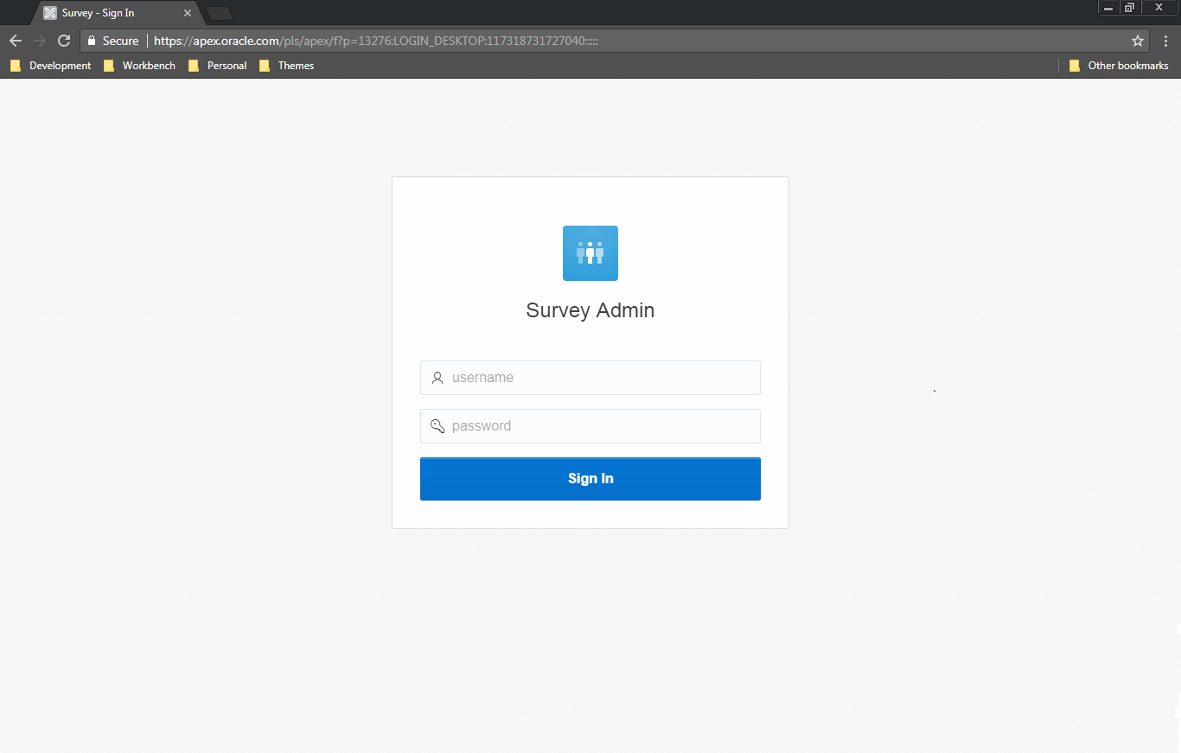

Slide 4
